Slide 1
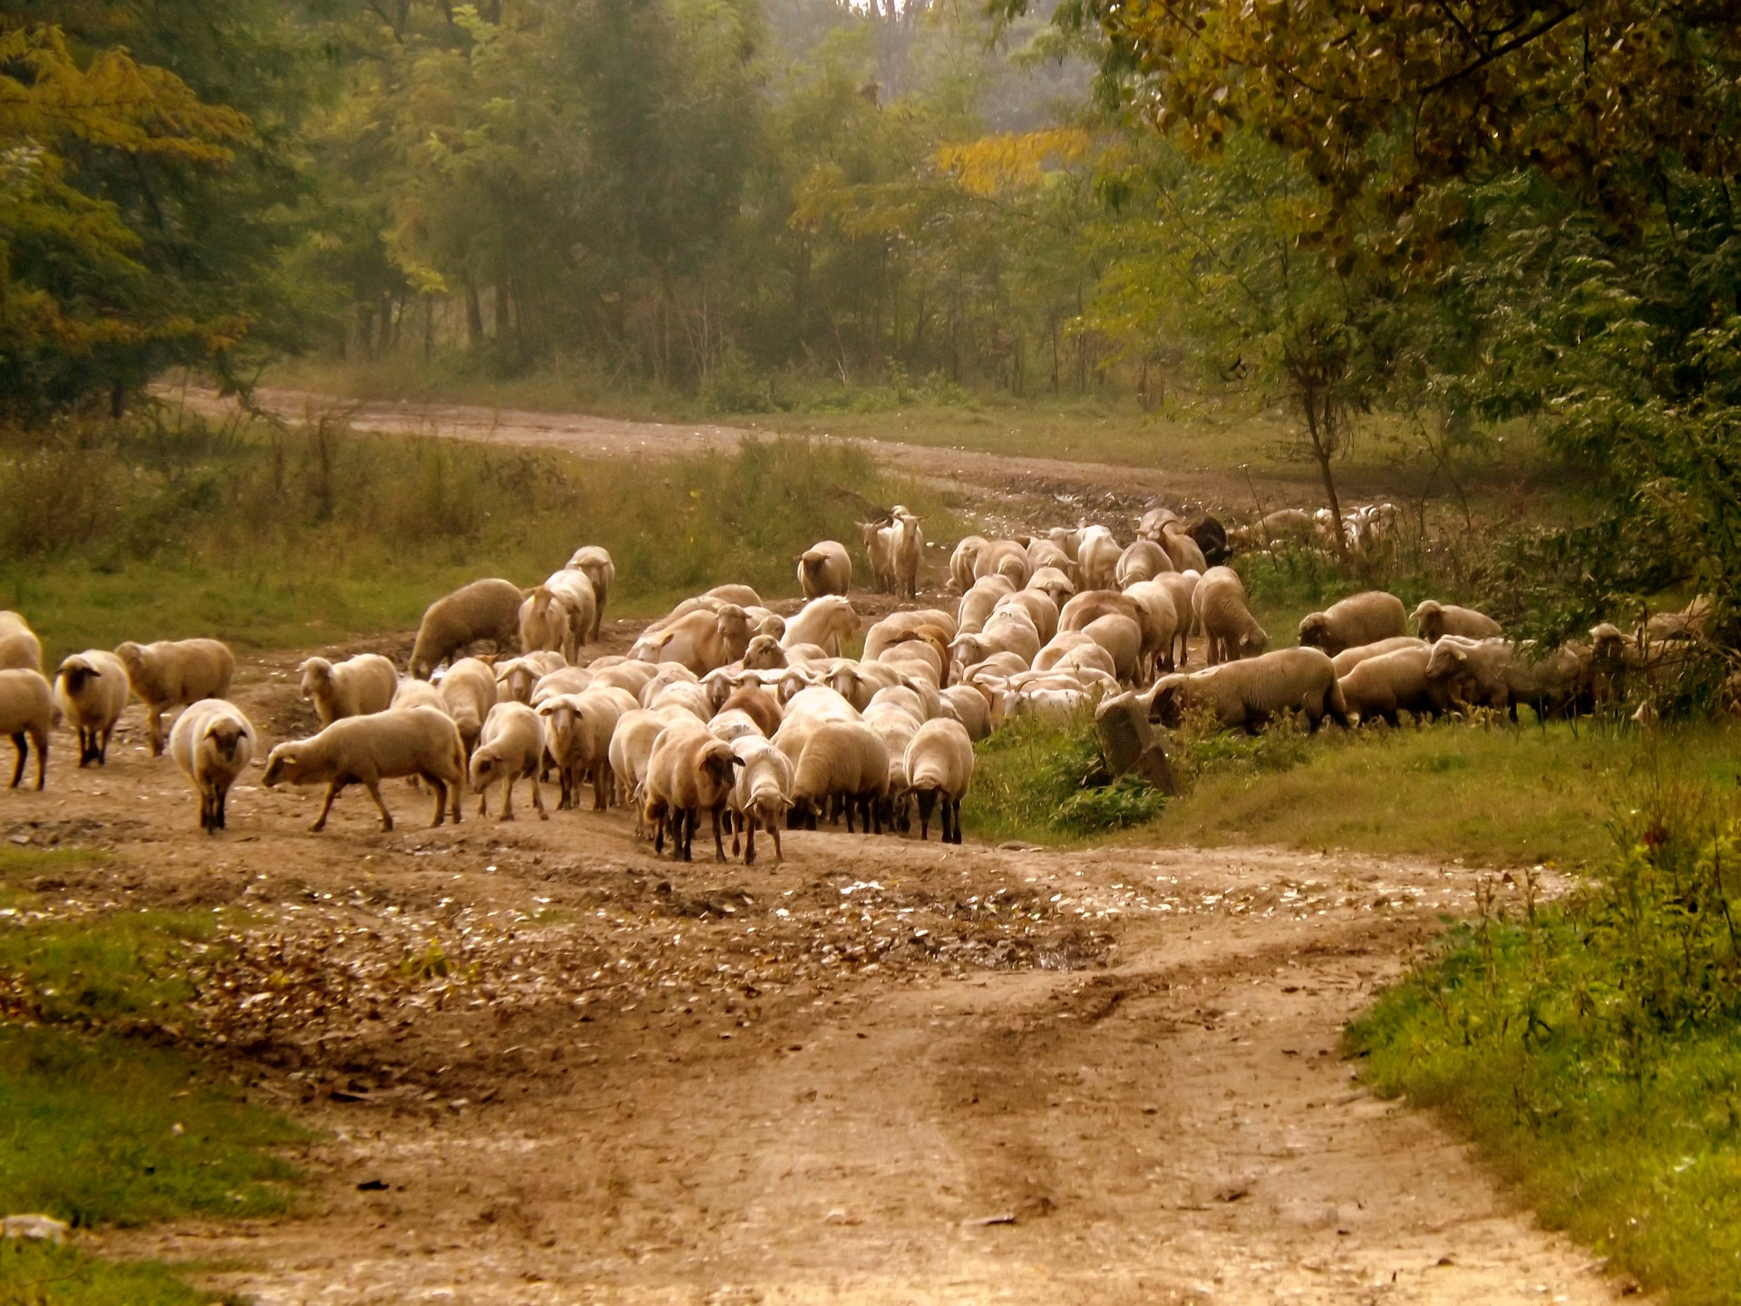
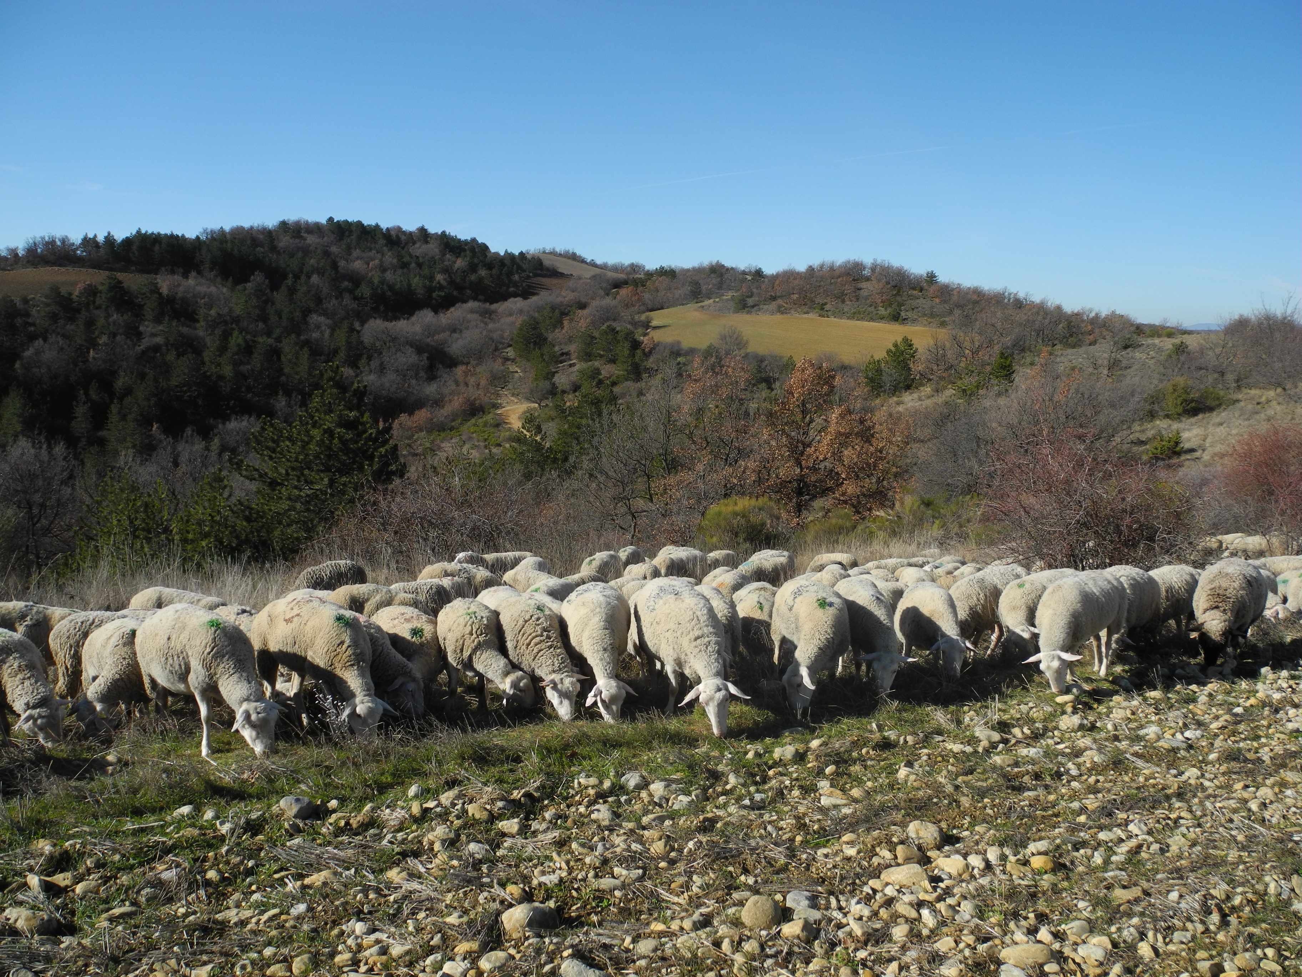
French Mountain sheep farming : a provider of environmental services
Session 7 : Sustainability and ecosystem services of mountain farming
S. Throude, C. De Boissieu, B. Nougadère, C. Vionnet, C. Rolland, B. Rouillé, J.B. Dollé
©Idele
Notes:
Again, good morning everyone, this is an honor to be able to present you the preliminary results of the LIFE Green Sheep project, and in particular the carbon footprint of sheep farms and its determinants. I am the spokeswoman for the work carried out collectively with the project's partner national leaders.

Slide 2
Location of sheep farms in France
Context
In France, 85% of sheep farms are located in mountain areas
Data from French government –
Artic software – Last update April 2024
Notes:
In France, 85% of sheep farms are located in mountain areas. In these areas, livestock farming is usually the only possible economic activity and the only way to preserve grasslands. Sheep farming provides a wide range of services, particularly environmental ones: maintaining biodiversity, sequestering carbon, preserving water quality for the most important.

Slide 3
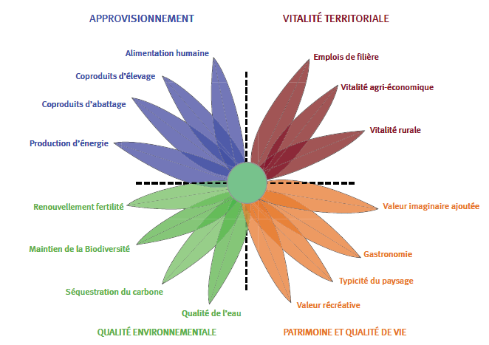
A wide range of services for mountain sheep farming
NUTRITION & PRODUCTION
TERRITORIAL VITALITY
Context
Human nutrition
Sector jobs
Livestock by-products
Agri-economic vitality
Slaughterhouse by-products
Rural vitality
Energy production
Soil quality
Added value
Biodiversity conservation
Gastronomy
Landscape character
Carbon sequestration
Water quality
Entertainment value
ENVIRONMENT
HERITAGE & LIFE QUALITY
Notes:
In France, 85% of sheep farms are located in mountain areas. In these areas, livestock farming is usually the only possible economic activity and the only way to preserve grasslands. Sheep farming provides a wide range of services, particularly environmental ones: maintaining biodiversity, sequestering carbon, preserving water quality for the most important.

Slide 4
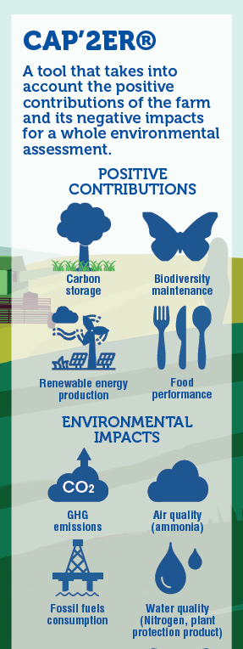
How to assess these environmental services?
Methodology
Using the CAP’2ER tool based on LCA
Objectives of this tool :
To assess environmental performances of a farm
To position itself in relation to references
To act to improve its practices
2 levels of assessment : level 1 (simplified) & level 2 (detailed)
For this study : use of level 1

Slide 5
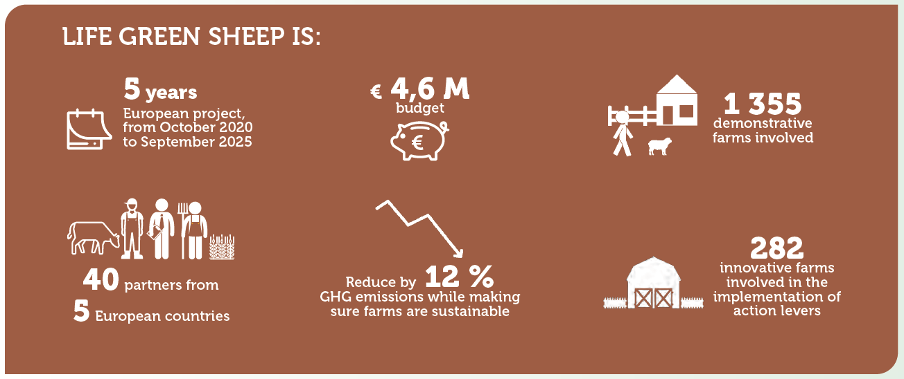
How to assess these environmental services?
Methodology
Using a large French farms sample from this project :
https://life-green-sheep.eu/

Slide 6
A FR-scale sample with a diversity of rearing sheep systems located in mountain areas
Results
164 French dairy sheep farms
256 French meat sheep farms
Roquefort Stocking rate value = 6,92 ewe/ha
PA : Pyrénées-Atlantiques
Grassland – Grass : time inside < 3 months
Grassland – Barn : time inside >5 months
Notes:
Data from 421 French sheep farms (257 meat and 164 dairy) representing various rearing systems located in mountain areas, the project provides a good overview of the contribution to maintain biodiversity, store carbon in soils and limit impacts on water quality of these systems.

Slide 7
Which environmental services ? Focus on biodiversity conservation
Results
eq ha of biodiv./ha
% of grasslands in total area used
1,3 (0,3 – 3,4)
89% (63 – 100)
1,7 (0,4 – 23,8)
87% (11 – 100)
>1 : increasing of biodiversity
0,5 – 1 : preservation of biodiversity
(Manneville, 2015)
Hedge rows (linear meter/ha used)
89 (13 – 258)
152 (10 – 918)
Preliminary results from LIFE Green Sheep project from 420 french sheep farms - 2024
Notes:
Preliminary results indicate a contribution to maintaining (ordinary) biodiversity of 2,1 and 1,4 eqha/ha for meat and dairy systems respectively. Moreover, mountain meat sheep farming helps to store 456 kg C/ha and 343 kg C/ha for dairy farms. It also limits nitrogen leaching, 12 and 32 kg N/ha for meat and dairy farms respectively, thanks to the use of grasslands and low use of inputs and mineral fertilizers. Compared with lowland systems, mountain systems contribute more to maintain biodiversity, store more carbon and leach less nitrogen.

Slide 8
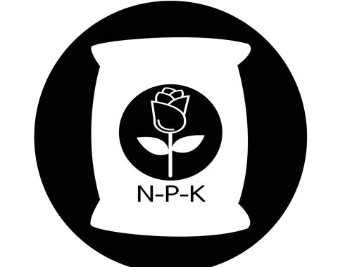
Which environmental services ? Focus on water quality
Results
kg leached N/ha
% of grasslands in total area used
34 (0 - 114)
89% (63 – 100)
12 (0 – 111)
87% (11 – 100)
34 for dairy sheep
20 for meat sheep
(Preliminary results of LIFE Green Sheep project – All systems, not only in mountains, 2024)
Mineral nitrogen (kg N/ha)
32 (0 – 97)
20 (0 – 165)
Preliminary results from LIFE Green Sheep project from 420 french sheep farms - 2024
Notes:
Preliminary results indicate a contribution to maintaining (ordinary) biodiversity of 2,1 and 1,4 eqha/ha for meat and dairy systems respectively. Moreover, mountain meat sheep farming helps to store 456 kg C/ha and 343 kg C/ha for dairy farms. It also limits nitrogen leaching, 12 and 32 kg N/ha for meat and dairy farms respectively, thanks to the use of grasslands and low use of inputs and mineral fertilizers. Compared with lowland systems, mountain systems contribute more to maintain biodiversity, store more carbon and leach less nitrogen.

Slide 9
Which environmental services ? Focus on carbon storage
Results
kg C/ha
% of grasslands in total area used
343 (63 – 703)
89% (63 – 100)
456 (48 – 3 342)
87% (11 – 100)
332 for dairy sheep
426 for meat sheep
(Preliminary results of LIFE Green Sheep project – All systems, not only in mountains, 2024)
Climate regulation (GHG emissions offsetting)
22%
65%
Preliminary results from LIFE Green Sheep project from 420 french sheep farms
Notes:
Preliminary results indicate a contribution to maintaining (ordinary) biodiversity of 2,1 and 1,4 eqha/ha for meat and dairy systems respectively. Moreover, mountain meat sheep farming helps to store 456 kg C/ha and 343 kg C/ha for dairy farms. It also limits nitrogen leaching, 12 and 32 kg N/ha for meat and dairy farms respectively, thanks to the use of grasslands and low use of inputs and mineral fertilizers. Compared with lowland systems, mountain systems contribute more to maintain biodiversity, store more carbon and leach less nitrogen.

Slide 10
A higher GHG emissions offsetting for moutain systems Ex of meat sheep farms
60%
12%
22%
50%
51%
91%
133%
Results
65%
12%
22%
50%
51%
91%
133%
Preliminary results from LIFE Green Sheep project from all FR meat sheep farms (635 farms)
Notes:
Preliminary results indicate a contribution to maintaining (ordinary) biodiversity of 2,1 and 1,4 eqha/ha for meat and dairy systems respectively. Moreover, mountain meat sheep farming helps to store 456 kg C/ha and 343 kg C/ha for dairy farms. It also limits nitrogen leaching, 12 and 32 kg N/ha for meat and dairy farms respectively, thanks to the use of grasslands and low use of inputs and mineral fertilizers. Compared with lowland systems, mountain systems contribute more to maintain biodiversity, store more carbon and leach less nitrogen.
Finally, mountain sheep systems also help to regulate the climate by offsetting an average of 22% and 65% of GHG emissions for dairy and meat systems respectively.

Slide 11
French Mountain sheep farming : a provider of environmental services
Conclusion
Not only negative impacts but also positive contributions !
An important contribution to climate regulation thanks to grassland & pastoral areas !
Lots of other services from sheep farms
More updated results to come soon ! Be connected with us ! ☺

Slide 12
Thanks for all French partners for these preliminary results !
Session 7 : Sustainability and ecosystem services of mountain farming
Financial supports
Notes:
Again, good morning everyone, this is an honor to be able to present you the preliminary results of the LIFE Green Sheep project, and in particular the carbon footprint of sheep farms and its determinants. I am the spokeswoman for the work carried out collectively with the project's partner national leaders.

Slide 13
Thanks for your attention
Session 7 : Sustainability and ecosystem services of mountain farming
Any questions ?
sindy.throude@idele.fr
©Idele
Notes:
Again, good morning everyone, this is an honor to be able to present you the preliminary results of the LIFE Green Sheep project, and in particular the carbon footprint of sheep farms and its determinants. I am the spokeswoman for the work carried out collectively with the project's partner national leaders.

